Slide 1


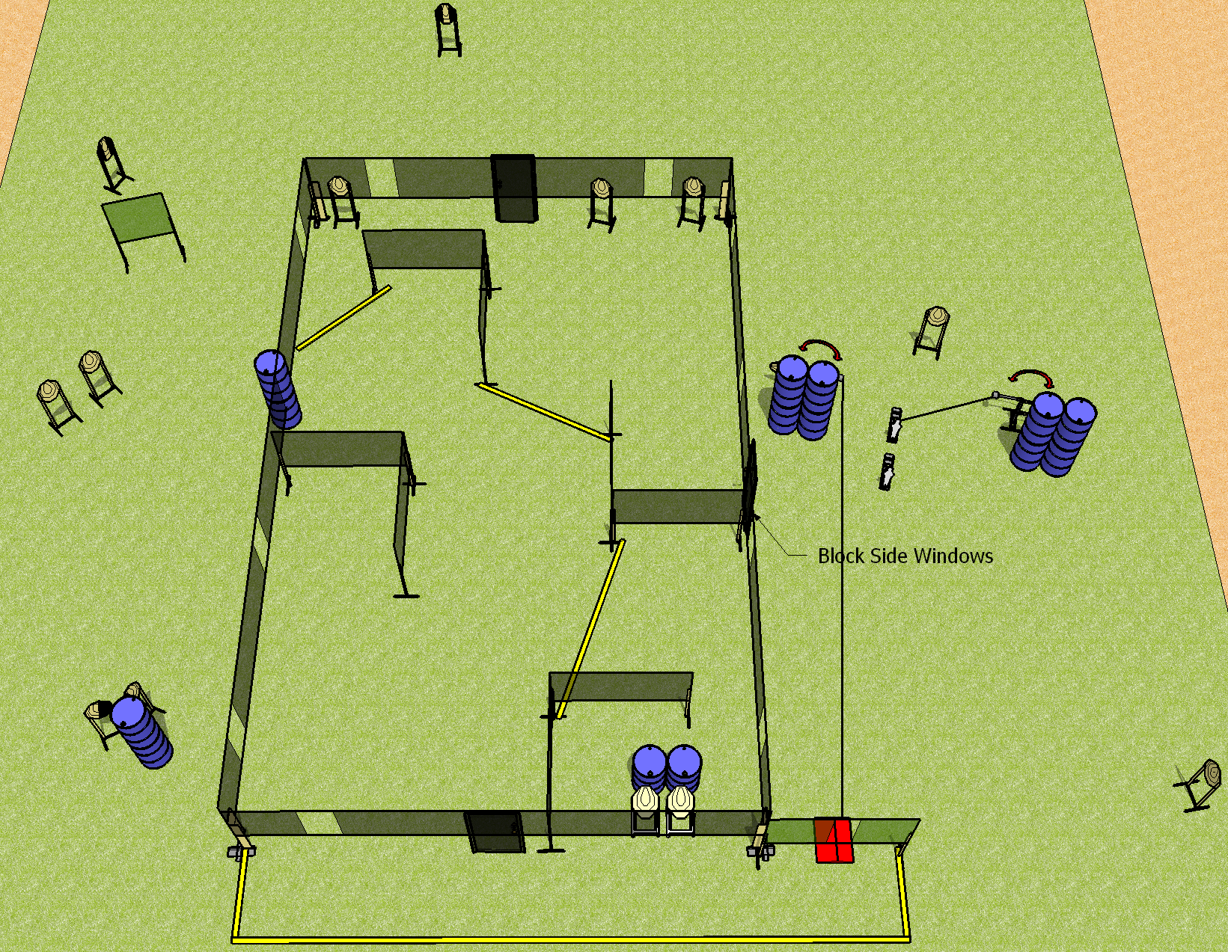
 | Dothan Gun Club – USPSA Match Call Your Shots Course Designer : Drew Coleman Bay: A4
Round Count 32 rounds 15 IPSC 2 mini poppers
Equipment List 4 wall feet 2 swingers + activator, stomp pad 1 left + 1 right diag, 1 tux

Slide 2
Call your Shots
Written Stage Briefing
Scoring: Comstock Rounds: 32
Targets: 15 IPSC, 2 steel
Handgun start position: anywhere inside the shooting area, wrists below belt. Handgun is loaded and holstered.
PCC start position: anywhere inside the shooting area, stock on belt. Loaded carbine is held with both hands, safety on.
Stage Procedure: On the audible start signal, engage targets as they become available from within the shooting area. Swinger 1 is activated by the stomp pad and remains visible at rest. Swinger 2 is activated by P2 and remains visible at rest.

